Slide 1
Correctness
A Quick Peek at Software Verification
Week 1 / Lecture 3
Franck Chauvel
Axbit & NTNU
franck.chauvel@ntnu.no

Slide 2




Correctness and Efficiency
Programs
Algorithms
Problems
correctness
Algorithm 1
efficiency
Algorithm 2

Slide 3
Agenda
What is Correctness?
How to test for Correctness?
How to prove Correctness?
In Practice

Slide 4
What is the Problem?
Requirements
Function
Decidability?
There is not an algorithm for every problem!
input
Problem
output

Slide 5
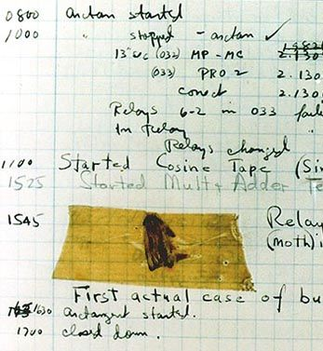
Correctness?
Partial Correctness
No bugs!
No invalid output for a valid input!
Termination

Slide 6


How to Argue for Correctness?
TEST
PROVE

Slide 7
Testing Practical Software Verification

Slide 8

How to Test?
Implement our algorithm
And try with some inputs
Check if the output is correct

Slide 9
Testing Termination
int main(int argc, char* argv[]){
int total = 0;
int each = 0;
while (each <= LIMIT) {
if (each % 2 == 0) {
total = total + each;
}
each = each + 1;
}
printf("%d\n", total);
}
int main(int argc, char* argv[]){
int total = 0;
int each = 0;
while (each <= LIMIT) {
if (each % 2 == 0) {
total = total + each;
}
each = each + 1;
}
printf("%d\n", total);
}
What if our algorithm does not return anything?
How long shall we wait?
As it failed?

Slide 10

“Testing shows the prescence, not the absence of bugs”
— Edsger W. Dijkstra (1930 – 2002)

Slide 11
Proofs
Formal Software Verification

Slide 12
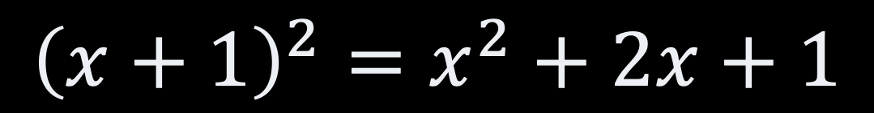
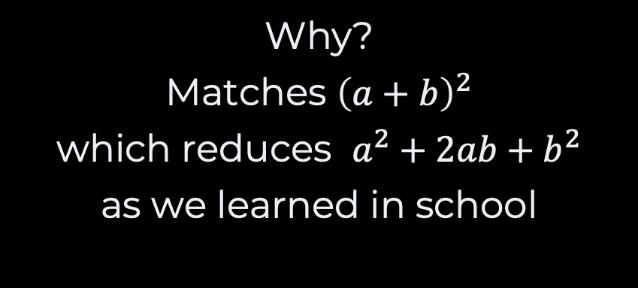
Informal Proofs
$${\left(x+1\right)}^{2}=x^{2}+2x+1$$
Why?
Matches ${\left(a+b\right)}^{2}$
which reduces $a^{2}+2ab+b^{2}$
as we learned in school

Slide 13

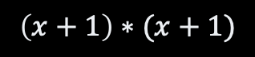
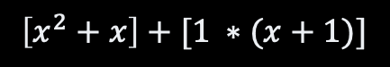

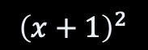
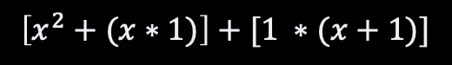
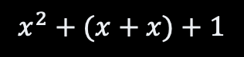
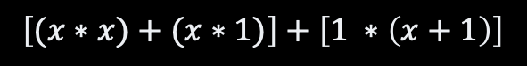
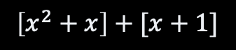


A Formal Proof
$${\left(x+1\right)}^{2}$$
definition of the square function
$$\left(x+1\right)∗(x+1)$$
$$x^{2}+2x+1$$
distributivity of x over +
Definition of x
$$\left[x ∗\left(x+1\right)\right]+[1 ∗(x+1)]$$
$$x^{2}+(x+x)+1$$
distributivity of x over +
associativity of +
$$\left[(x∗x)+(x∗1)\right]+\left[1 ∗\left(x+1\right)\right]$$
$$\left[x^{2}+x\right]+[x+1]$$
definition of the square function
identity element of x
$$\left[x^{2}+(x∗1)\right]+[1 ∗(x+1)]$$
$$\left[x^{2}+x\right]+\left[x+\left(1∗1\right)\right]$$
identity element of x
identity element of x
$$\left[x^{2}+x\right]+[1 ∗(x+1)]$$
$$\left[x^{2}+x\right]+\left[\left(1∗x\right)+\left(1∗1\right)\right]$$
distributivity of x over +

Slide 14
Formal Proofs Programs
CPU
Memory
CPU
Memory
each := each + 1
ACC
each
x
ACC
each
x+1
IP
IP
Pseudo-code
Executor before
Executor after

Slide 15
Proving Programs
ACC := value
IP := IP + 2
LOAD value
Pseudo-code
each := each + 1
CPU
Memory
CPU
Memory
ACC
each
x
ACC
1
each
x
y
y+2
IP
IP
y
y
LOAD
LOAD
LOAD
y
LOAD
1
1
y+1
1
y+1
1
RAM assembly
y+2
ADD
y+2
ADD
load 1 add each store each
ADD
load 1 add each store each
each
each
y+3
y+3
each
y+4
STO
y+4
STO
y+5
each
y+5
each

Slide 16
Proving Programs
ACC := ACC + memory[address]
IP := IP + 2
ADD address
Pseudo-code
each := each + 1
CPU
Memory
CPU
Memory
ACC
1
each
x
ACC
x+1
each
x
y+2
y+2
IP
IP
y+4
y
LOAD
y
LOAD
y+1
1
y+1
1
RAM assembly
y+2
ADD
ADD
load 1 add each store each
ADD
y+2
ADD
each
each
y+3
each
y+3
each
y+4
STO
y+4
STO
STO
each
each
y+5
y+5
each

Slide 17
Proving Programs
memory[address] := ACC
IP := IP + 2
STORE address
Pseudo-code
each := each + 1
CPU
Memory
CPU
Memory
x
x+1
ACC
x+1
each
ACC
x+1
each
x
y+4
y+6
IP
IP
y+4
y
LOAD
y
LOAD
y+1
1
y+1
1
RAM assembly
load 1 add each store each
y+2
ADD
y+2
ADD
y+3
each
y+3
each
y+4
STO
y+4
STO
STO
each
each
y+5
y+5
each

Slide 18
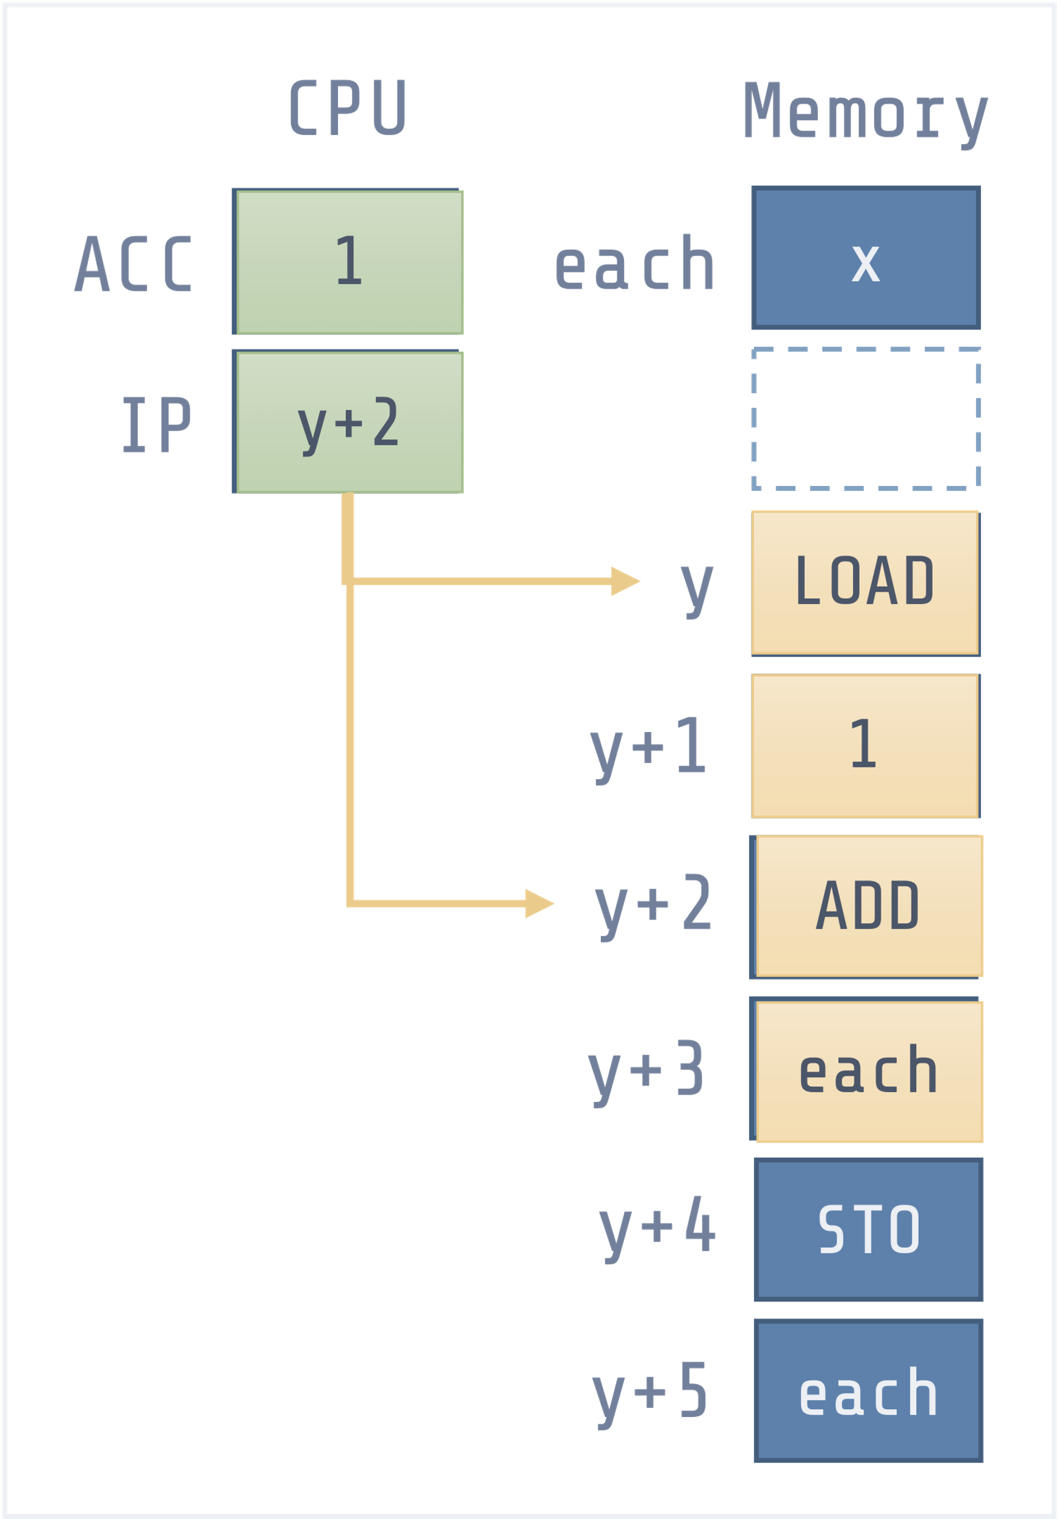
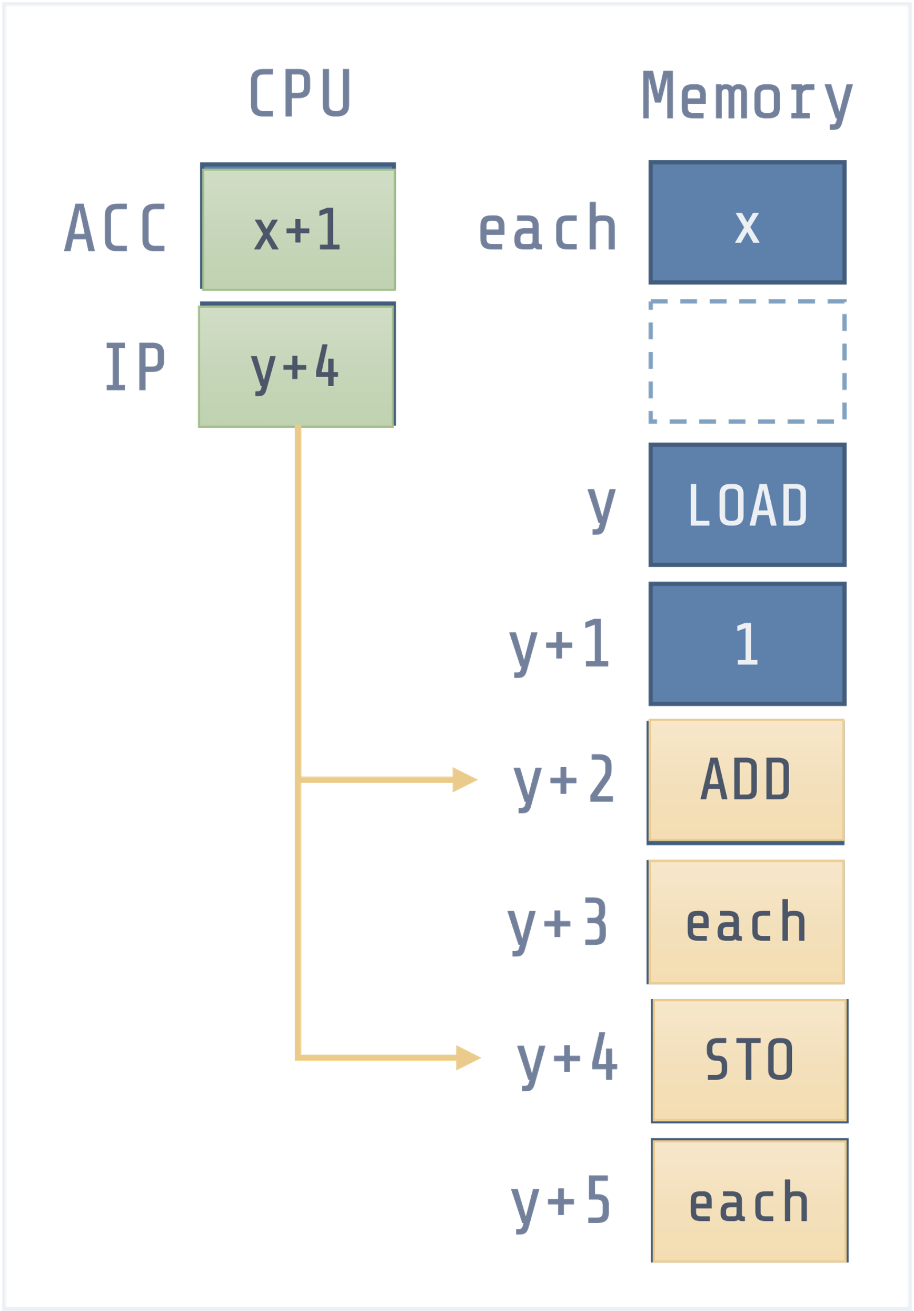
Proving Programs
CPU
Memory
CPU
Memory
each := each + 1
ACC
each
x
ACC
each
x+1
IP
IP
Pseudo-code
Executor before
Executor after
LOAD 1
ADD address
STORE address

Slide 19
Takeaway #1
Formal proofs are difficult

Slide 20
Proving “Bigger” Programs
int main(int argc, char* argv[]){
int total = 0;
int each = 0;
while (each <= LIMIT) {
if (each % 2 == 0) {
total = total + each;
}
each = each + 1;
}
printf("%d\n", total);
}

Slide 21
Hoare Logic
{P}
code
{Q}
Pre-condition
true about
the executor state
before the instruction
Post-condition
Something true about
the executor state
after the instruction
{true}
var := 25
{var = 25}
{var < 10}
var := var + 1
{var ≤ 10}

Slide 22






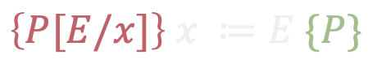


Deduction Rules Hoare Logic
$$\left\{P∧T\right\} C_{1} \{Q\}$$
$$\left\{P∧¬T\right\} C_{2} \{Q\}$$
assignment
conditional
$$\left\{P[E/x]\right\} x ≔E \{P\}$$
$$\left\{P\right\} if T then C_{1} else C_{2} \{Q\}$$
$$\left\{P\right\} C_{1} \{R\}$$
$$\left\{R\right\} C_{2} \{Q\}$$
$$\left\{P∧T\right\} C \{Q\}$$
sequence
loop
$$\left\{P\right\} C_{1} ;C_{2} \{Q\}$$
$$\left\{P\right\} while T do C \{¬T∧Q\}$$

Slide 23
Recap
Correctness
Correct result
Termination
Testing
Practical but weak
Only shows there is a problem
Proofs
Stronger, but much harder
Require an model of computation
Inference Rules (Hoare Logic)
Loop invariants
In practice
Only Testing for most systems
Not only to find bugs
Testing is critical
Proofs + tests
Some safety critical systems
Cryptography
Device drivers

Slide 24

Lab Session
Unit Testing
Java with Junit
Python with Unittest
Javascript with Jest
C/C++ with Boost.test
Practical

Slide 25
Questions, Comments, or Ideas?
Franck Chauvel
Axbit & NTNU
franck.chauvel@ntnu.no

